Slide 1

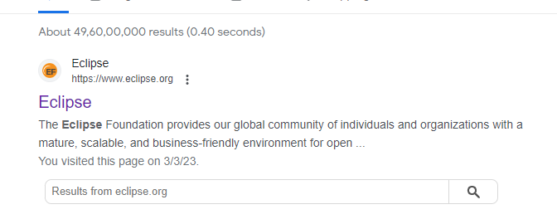
STEPS TO INSTALL ECLIPSE
Step 1:- use any browser and type eclipse press enter. Click on the official website of eclipse.
https://www.eclipse.org

Slide 2

Step 2:-click on the downloads button which is in the top right corner of the page.

Slide 3
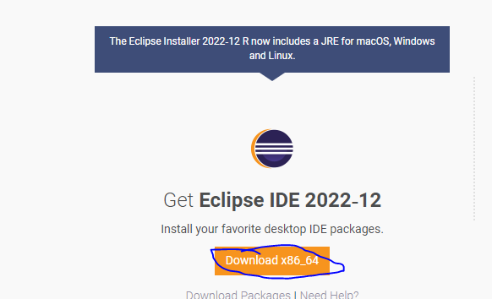
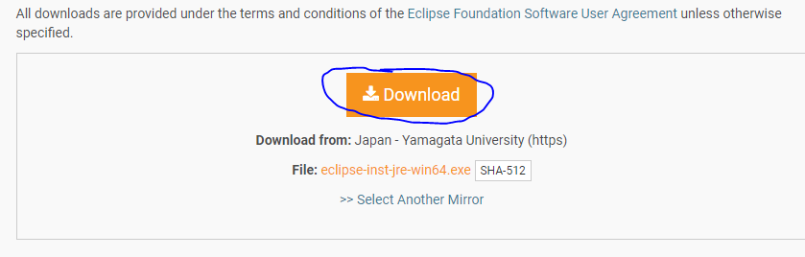
Step 3:- scroll down click on the download button Download x86_64.
Click on the download.

Slide 4

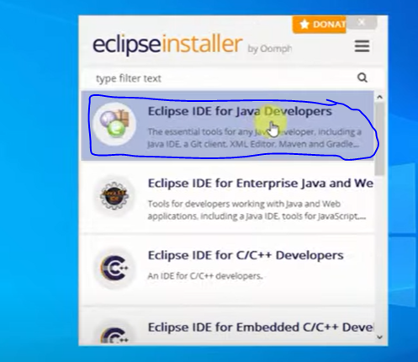
Step 4:- download will start and double click on the downloaded file to install.
Click on the eclipse ide for java developers.

Slide 5
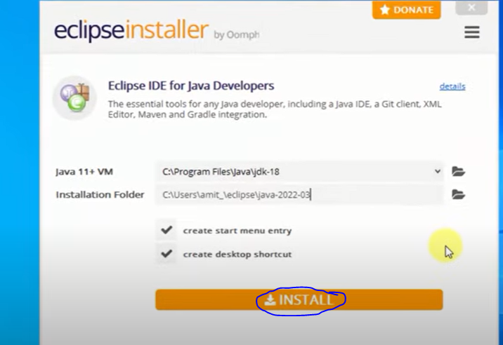
Step 5:-click on the install button

Slide 6
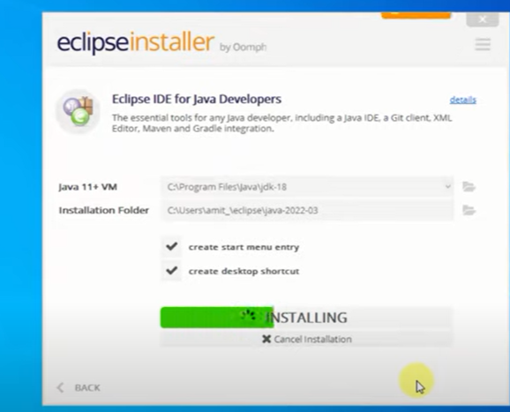
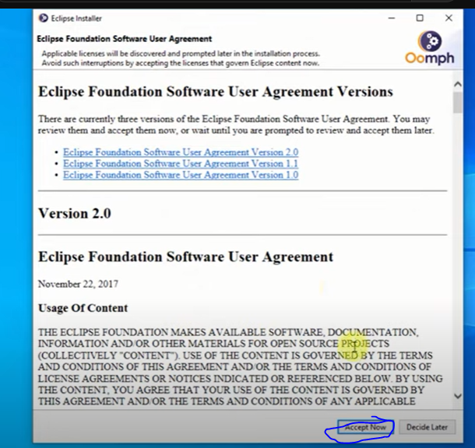
Step 6:- click on the accept now on user agreement page and the installation will start.

Slide 7
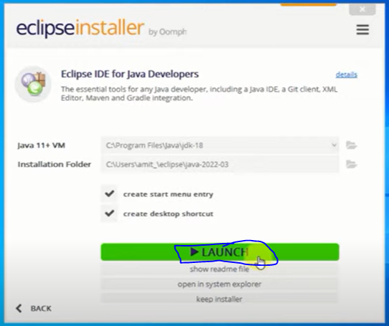
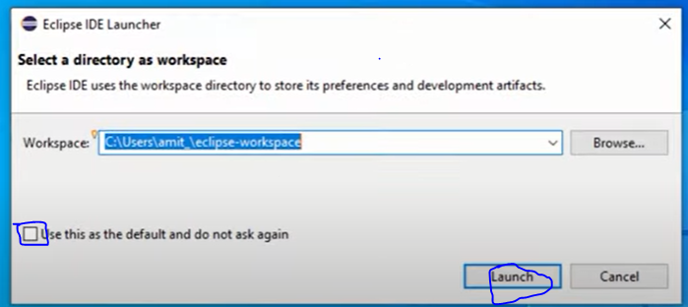
Step 7:- once after completing the installation click on the launch button. It asks for the select directory for workspace and click on the check box which is provided in left down corner, click on launch.

Slide 8
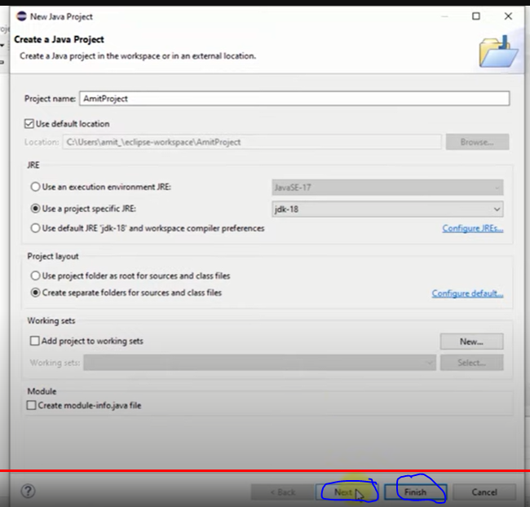
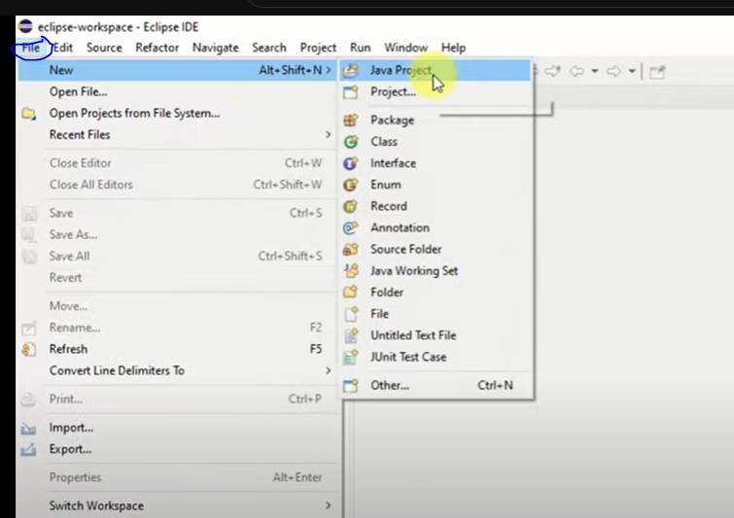
Step 8:- successfully we installed eclipse and to create project go to file->new->java project click on it , enter the name of project and click on next , finish.

